Slide 1

CAPSTONE PROJECT - 3 Coronavirus Tweet Sentiment Analysis
COHORT - OSLO
TEAM MEMBER:
ANUP A. JAMBULKAR
VIBHU SHARMA
GAURAV MALAKAR
ANKIT WALDE
ANIL BHATT

Slide 2


POINTS FOR DISCUSSION
Problem statement
Data Summary
Importing libraries
Text-Preprocessing
EDA
Model preprocessing (CV & TF/IFD)
Model Training
Confusion matrix and performance metrics
Conclusion
Challenges

Slide 3

Problem Description
This challenge asks us to build a classification model to predict the sentiment of COVID-19 tweets. The tweets have been pulled from Twitter and manual tagging has been done then.
The names and usernames have been given codes to avoid any privacy concerns. We are given the following information:
Location
Tweet At
Original Tweet
Label

Slide 4

Data Summary
We are given the dataset having 6 columns –
UserName
Screenname
Location
TweetAt
OriginalTweet
Sentiment

Slide 5

Importing Libraries & Data Inspection
Pandas – Manipulation of tabular data in Dataframes
Numpy – Mathematical operations on arrays
Matplotlib – Visualization
Seaborn – Visualization
Sklearn – Data Modeling
Nltk – Pre Processing / Feature Engineering
WordCloud – Visualization
.

Slide 6
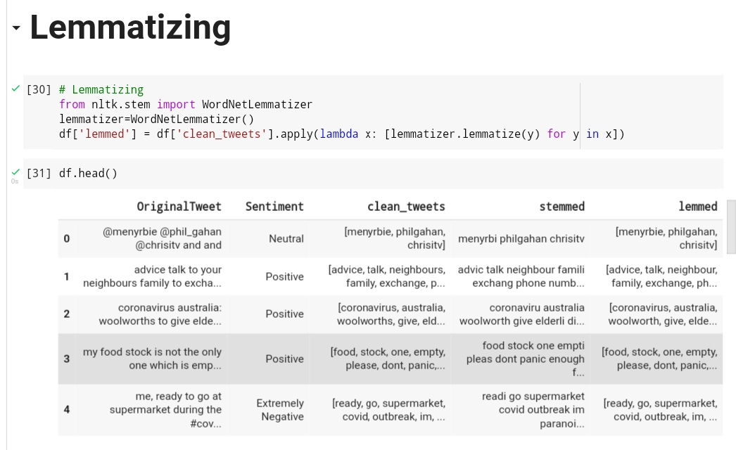
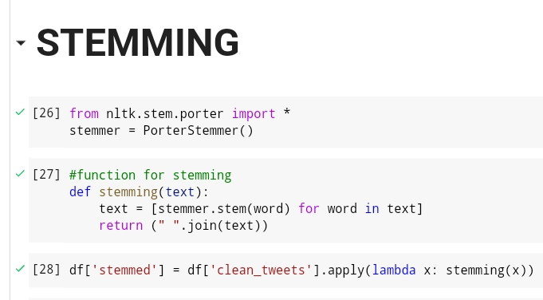
Text Pre-processing
Step 1 : Converted all characters to lowercase. Step 2 : Removed Punctuation.
Step 3 : Removed stop words.
Step 4: Stemming
Step 5: Lemmatizing

Slide 7

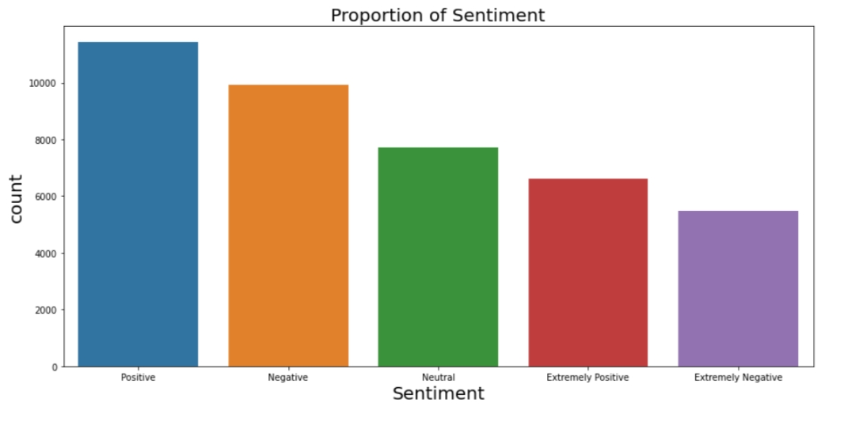













Exploratory Data Analysis
Sentiments

Slide 8
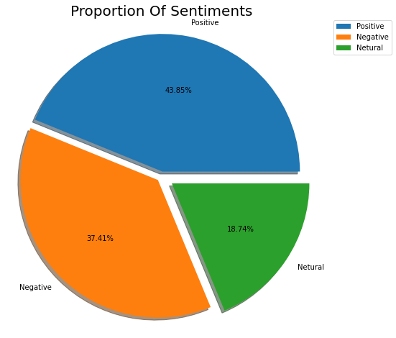
EDA Continued…
New Sentiments
As there
was five types of sentiments – Positive
Sentiment, Extremely Positive Sentiment, Negative Sentiment, Extremely Negative Sentiment and Neutral Sentiment. So, we have replaced Extremely Positive Sentiment by Positive Sentiment and Extremely Negative Sentiment by Negative Sentiment. Now we have three types of sentiments – Positive Sentiment, Negative Sentiment and Neutral Sentiment.
The Pi Chart shows the proportion of each sentiment.
There are 43.85% Positive Sentiments,37.41% Negative Sentiments and 18.74% Neutral Sentiments.
Positive Sentiments are having higher proportion among all.

Slide 9
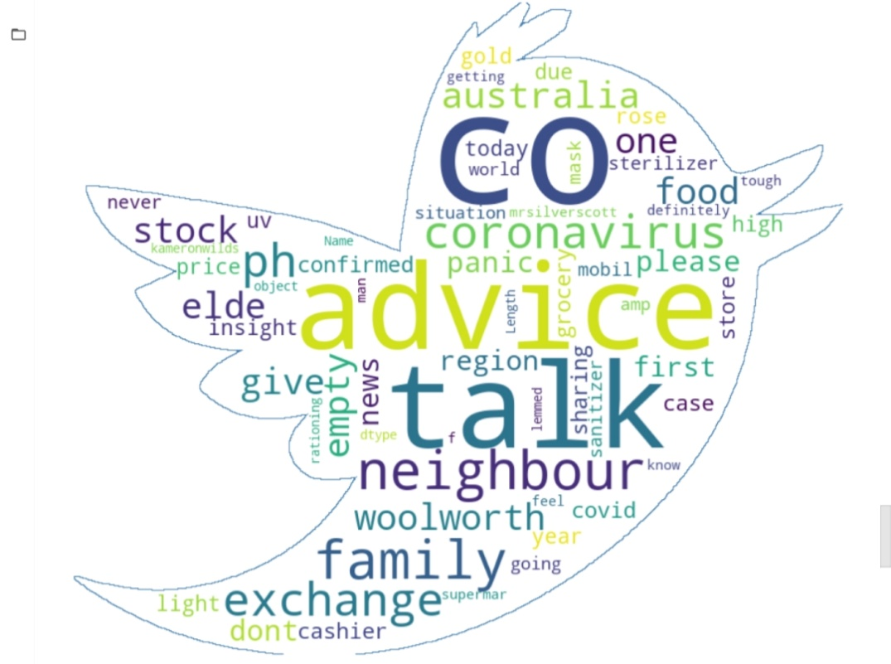
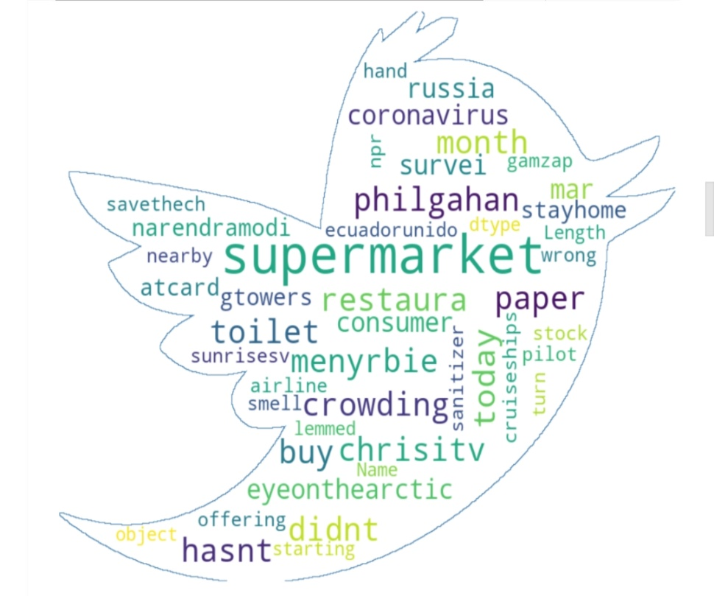
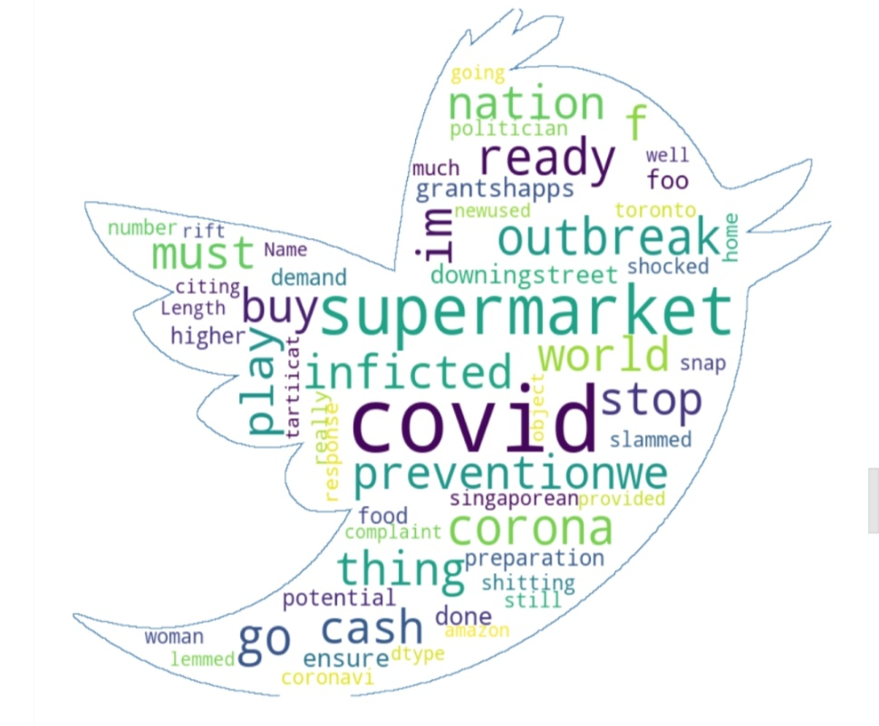
EDA Continued…
Word cloud
Word Clouds are visual displays of text data – simple text analysis. Word Clouds display the most prominent or frequent words in a body of text.
1. Positive Words
2. Neutral Words
3.Negative Words

Slide 10













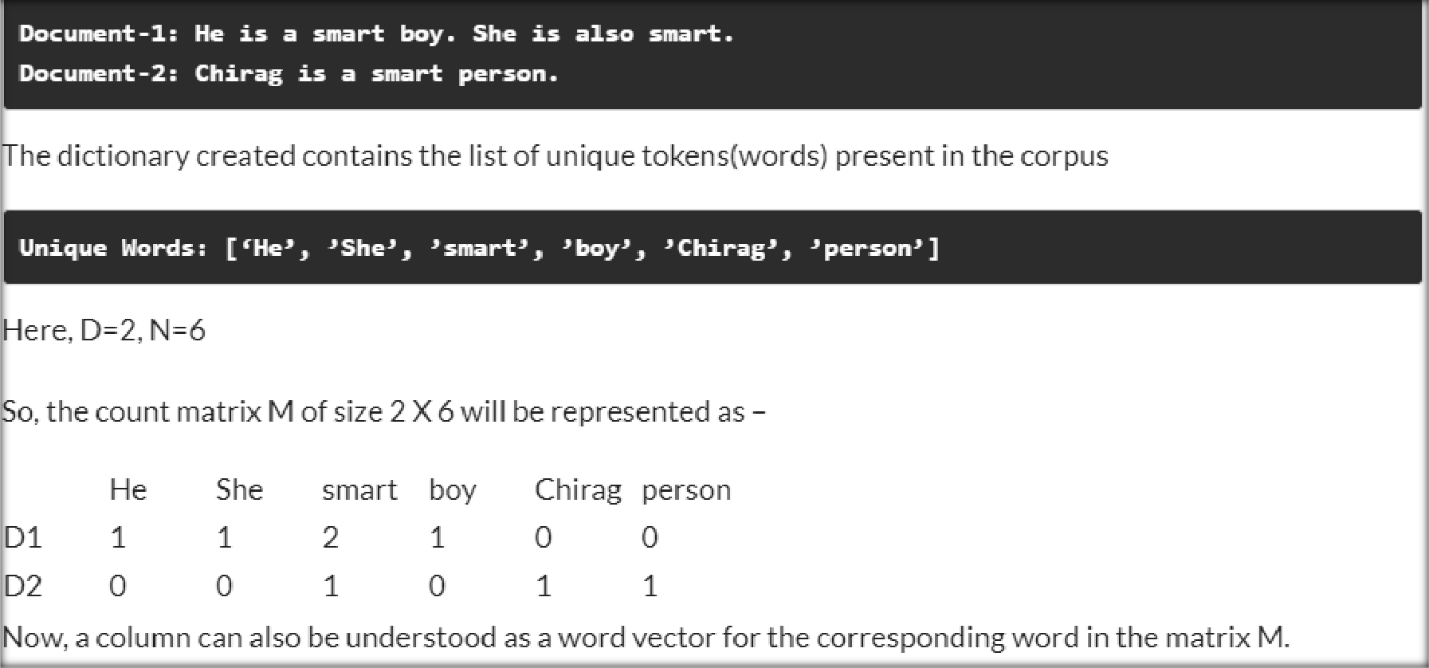
Model Preprocessing
Count Vectorizer - CountVectorizer is a great tool provided by the scikit-learn library in Python. It is used to transform a given text into a vector on the basis of the frequency (count) of each word that occurs in the entire text.

Slide 11









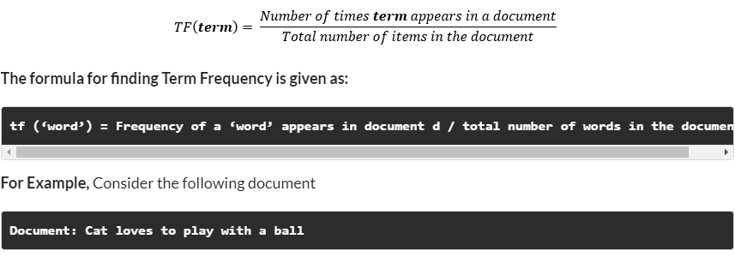
Model Preprocessing
TF-IDF -
Count Vectorizer method is simple and works well, but the problem with that is that it treats all
words equally. As a result, it cannot distinguish very common words or rare words. So, to solve this problem, TF-IDF comes into the picture! Term frequency-inverse document frequency ( TF-IDF) gives a measure that takes the importance of a word into consideration depending on how frequently it occurs in a document and a corpus.
Term frequency denotes the frequency of a word in a document.
It is the percentage of the number of times a word (x) occurs in a particular document (y) divided by the total number of words in that document

Slide 12
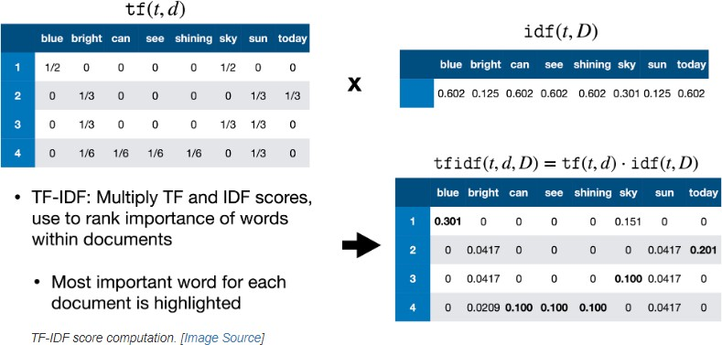
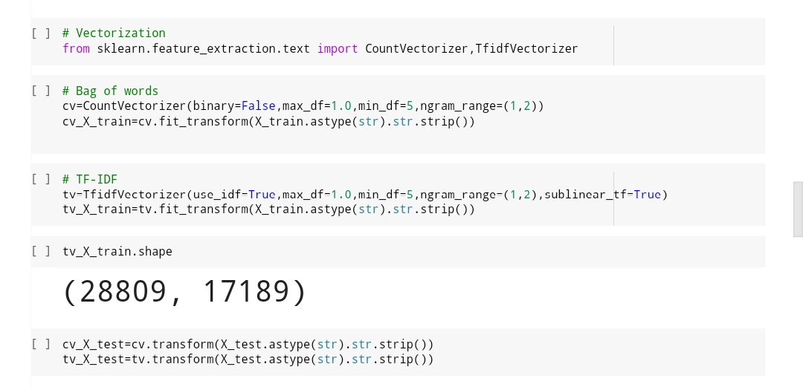
Model Preprocessing
Inverse Document Frequency - It measures the importance of the word in the corpus. It measures how common a particular word is across all the documents in the corpus.
It is the logarithmic ratio of no. of total documents to no. of a document with a particular word.
The difference in the TF-IDF method is that each cell doesn’t indicate the term frequency, but contains
a weight value that signifies how important a word is for an individual text message or document

Slide 13

Model Training
Model Used
Logistic Regression with Grid Search CV
Decision Tree Classifier
XG Boost Classifier
KNN Classifier
SVM Classifier

Slide 14
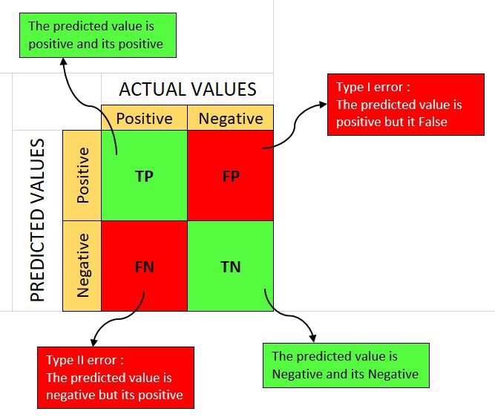
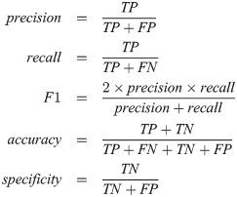

Performance metrics of classification models

Slide 15


Precision
Precision Accuracy And Recall
Precision is the proportion of correct predictions among all predictions of a certain class. In other words, it is the
proportion of true positives among all positive predictions.
Accuracy
Accuracy is the proportion of examples that were correctly classified. More precisely, it is sum of the number of true positives and true negatives, divided by the number of examples in the dataset.

Slide 16

Precision Accuracy And Recall
Recall
Recall is the proportion of examples of a certain class that have been predicted by the model as belonging to that class. In other words, it is the proportion of true positives among all true examples.

Slide 17
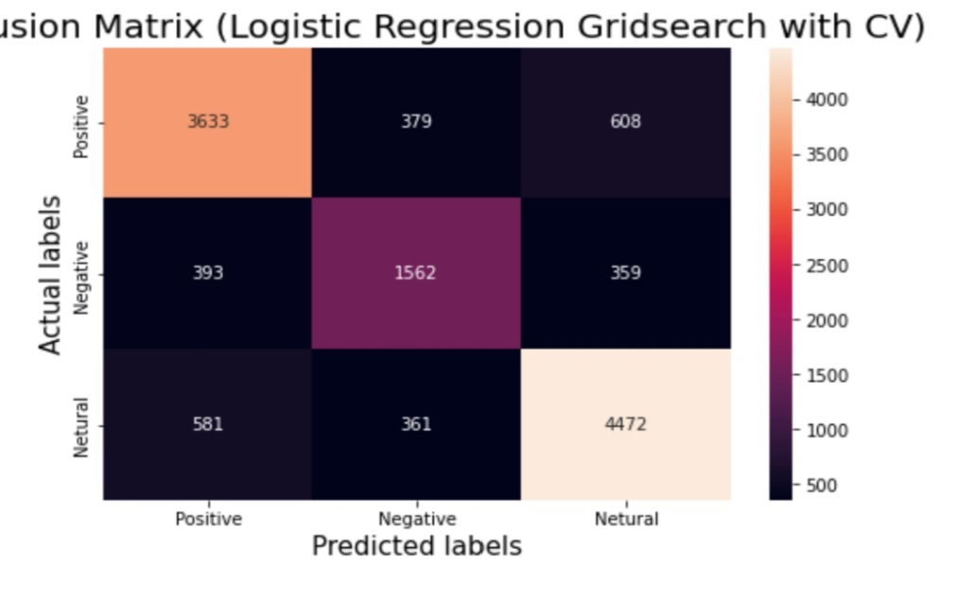
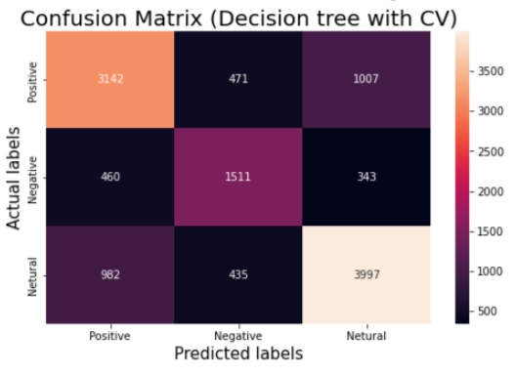
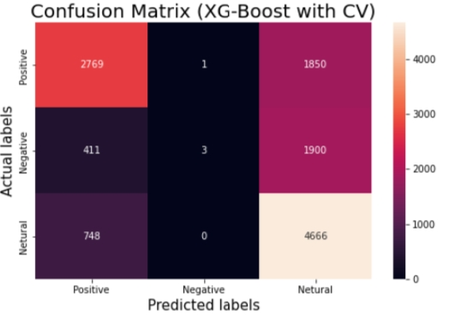
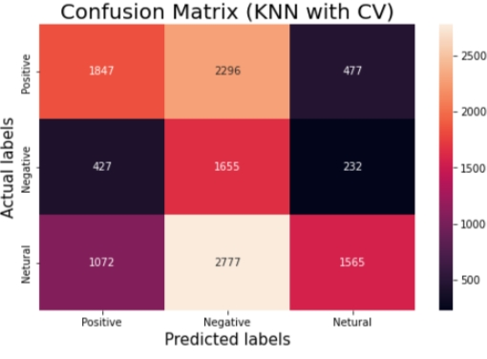

Confusion Matrix (count vector)
A Confusion matrix is an N x N matrix used for evaluating the performance of a classification model, where N is the number of target classes.

Slide 18

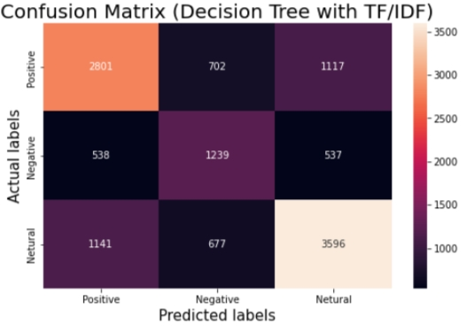
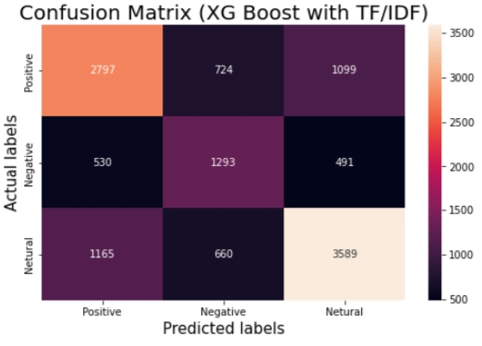
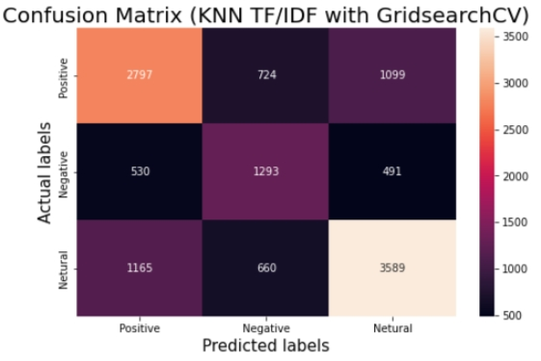
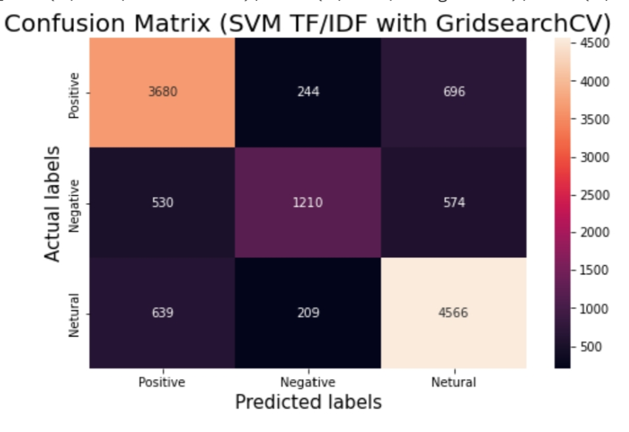
Confusion Matrix (TF-IDF Vector)

Slide 19

Performance Metrics and Accuracy (count vector)
Performance of Logistic Regression Model
Performance of Decision Tree Classifier
Performance of XG Boost Classifier
Performance of KNN Classifier
Performance of SVM Classifier
Precision Recall F1-score
Negative 0.79 0.79 0.79
Neutral 0.68 0.68 0.68
Positive 0.82 0.83 0.82
Accuracy 0.78
Precision Recall F1-score
Negative 0.55 0.40 0.46
Neutral 0.25 0.72 0.37
Positive 0.69 0.29 0.41
Accuracy 0.41
Precision Recall F1-score
Negative 0.69 0.68 0.68
Neutral 0.62 0.67 0.64
Positive 0.75 0.74 0.75
Accuracy 0.70
Precision Recall F1-score
Negative 0.77 0.75 0.76
Neutral 0.65 0.66 0.66
Positive 0.80 0.81 0.80
Accuracy 0.76
Precision Recall F1-score
Negative 0.70 0.60 0.79
Neutral 0.75 0.00 0.68
Positive 0.55 0.86 0.67
Accuracy 0.60

Slide 20
Performance Metrics and Accuracy (TF/IDF Vector)
Performance of Logistic Regression Model
Performance of Decision Tree Classifier
Performance of XG Boost Classifier
Performance of KNN Classifier
Performance of SVM Classifier
Precision Recall F1-score
Negative 0.78 0.79 0.79
Neutral 0.66 0.62 0.64
Positive 0.81 0.82 0.82
Accuracy 0.77
Precision Recall F1-score
Negative 0.37 1.00 0.55
Neutral 0.93 0.01 0.01
Positive 0.33 0.00 0.00
Accuracy 0.38
Precision Recall F1-score
Negative 0.62 0.60 0.61
Neutral 0.48 0.55 0.51
Positive 0.68 0.66 0.67
Accuracy 0.62
Precision Recall F1-score
Negative 0.76 0.80 0.78
Neutral 0.73 0.52 0.61
Positive 0.78 0.82 0.81
Accuracy 0.77
Precision Recall F1-score
Negative 0.63 0.61 0.62
Neutral 0.48 0.55 0.51
Positive 0.68 0.66 0.67
Accuracy 0.62

Slide 21
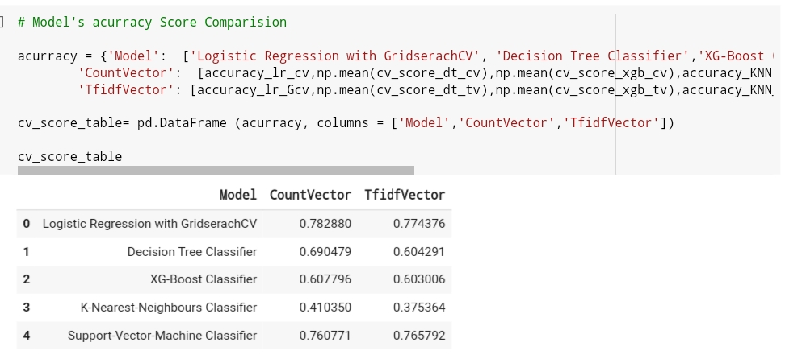
Conclusion
We applied 5 models namely, Logistic Regression with Grid Search CV, Decision Tree Classifier, XG Boost, KNN, and SVM Classifier for both Count Vector And TF ID Vectorization techniques.
We conclude that the machine is generating the best results for the Logistic Regression with Grid Search CV (count vectorizer) model with an Accuracy of 78.28% followed by the Logistic Regression with Grid Search CV (TF/ID vectorizer) model with an Accuracy of 77.43%.
Also, we observed that no overfitting is seen for the data, and we can deploy this model.
The sentiments of future tweets can be easily predicted using this model.
Even being in the unprecedented situation of CoVid-19, people's positive sentiments outnumbered negative sentiments. However, negative sentiments also has a significant chunk which various Government agencies, NGOs, etc. can use to help boost the morale of the people and then in future repeat the analysis and comparing it with the present sentimental analysis to gauge the impact of the initiatives on the ground.

Slide 22

CHALLENGES FACED
Text preprocessing.
Vectorization.
Model Training and performance improvement.

Slide 23


